Slide 1

Java Streams
Dima Ionut Daniel

Slide 2
Contents
What is Java?
History
Streams
Data Parallelism
Conclusions
Bibliography

Slide 3

What is Java?
Java is a programming language created by Sun Microsystems.
Java is used in a wide variety of computing platforms from embedded devices and mobile phones on the low end, to enterprise servers and supercomputers on the high end.
Memory management is handled through integrated automatic garbage collection performed by the JVM.
The heart of the Java platform is the concept of a "virtual machine" that executes Java bytecode programs. This bytecode is the same no matter what hardware or operating system the program is running under.
There is a JIT(Just-In-Time) compiler within the Java Virtual Machine, or JVM. The JIT compiler translates the Java bytecode into native processor instructions at run-time and caches the native code in memory during execution.
The Java programs are cross-platform or platform independent, but the code of the Java Virtual Machines (JVM) that execute these programs is not.

Slide 4
History
The initial Java release was named Oak, and the first stable version was JDK 1.0.2, called Java 1.
JDK 1.0 - 23 January 1996
JDK 1.1 – 19 February 1997
J2SE 1.2 – 8 December 1998 (codename Playground)
J2SE 1.3 – 8 May 2000 (codename Kestrel)
J2SE 1.4 – 6 February 2002 (codename Merlin)
J2SE 5.0 – 30 September 2004 (codename Tiger)
Java SE 6 – 11 December 2006 (codename Mustang)
Java SE 7 – 7 July 2011(codename Dolphin)
Java SE 8 – 18 March 2014 (codename Spider)
Java SE 9 – planned for 2016

Slide 5
Streams
Streams are used with collections.
The Stream interface is in the java.util.stream package.
Unlike the Iterator, it supports parallel execution.
The Stream interface supports the map/filter/reduce pattern and executes lazily, forming the basis (along with lambdas) for functional-style programming in Java 8.
There are also corresponding primitive streams (IntStream, DoubleStream, and LongStream) for performance reasons.
The Collection interface has two 2 methods for creating streams:
stream(): Returns a sequential Stream with the collection as its source.
parallelStream(): Returns a possibly parallel Stream with the collection as its source.

Slide 6
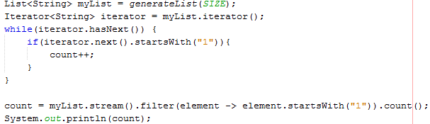
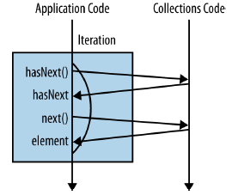
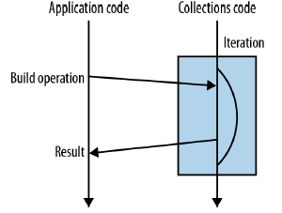
Streams (cont.)
A new addition was added to Collections API: Streams.
Streams allows the writing of collections-processing code at a higher level of abstraction.
The stream() method performs the similar role to the call as iterator().

Slide 7
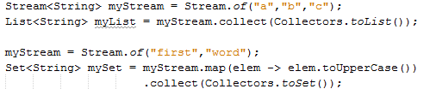

Streams (cont.)
Stream object can be converted to Set, List or individual operation can be performed on List elements based on different methods.
Filter method can be called on a stream to execute individual code when the elements are retrieved from Stream.

Slide 8
Streams (cont.)
The filter() operation can be used to filter elements and is an intermediate operation.
Stream does not store the elements; it simply performs aggregate operations to get the desired stream of data.
The aggregate operations that we perform on the collection, array or any other data source do not change the data of the source, it's only returning a new stream.
All stream operations are lazy in nature, which means they are not executed until they are needed.

Slide 9
Streams (cont.)
Streams can be concatenated with method static method Stream.concat().
We can create a stream from individual objects using the static method Stream.of().
The map() method is used to map each element to its corresponding result.
Stream has provided a new method forEach() to iterate each element of the stream.
The filter() method is used to eliminate elements based on a criteria.

Slide 10
Streams (cont.)
The limit() method is used to reduce the size of the stream.
min() and max() methods return the minim and the maximum element in the stream, based on a comparator.
distinct() method can be used to eliminate duplicate elements from the stream. It uses equals() method to decide either 2 elements are equals or not.
The sorted() method is used to sort the stream.
Collectors are used to combine the result of processing on the elements of the stream.
findFirst() returns an Optional for the first entry in the stream.

Slide 11
Streams (cont.)
Stream is a stream of object references.
There are also IntStream, LongStream, DoubleStream, which are primitive specialization for int, long and double respectively. These specialized streams do not extend Stream but extend BaseStream on top of which Stream is also built.
Specialized streams provide additional operations as compared to the standard Stream: sum(), average(), range().

Slide 12
Streams (cont.)
A reduction operation, also called as fold takes a sequence of input elements and combines them into a single summary result by released application of a combining operations.
The most common for of reduce() is: T reduce(T identity, BinaryOperation<T> accumulator).
groupBy() method groups elements of the stream with the use of a Map.

Slide 13
Streams (cont.)
The takeWhile() method it takes elements from a stream while given condition is true. The moment the condition becomes false, it quits and returns a new string with just the elements that matched the predicate.
The dropWhile() method does pretty much the same thing the take while does but in reverse.

Slide 14
Streams (cont.)
Pros:
Parallel stream implementations are often much faster & more scalable than sequential stream & loops implementations
Cons:
It behaviors aren't thread-safe and race conditions may occur
All parallel streams share a common fork-join pool

Slide 15
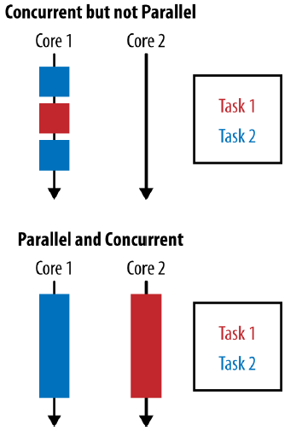
Data Parallelism
Concurrency occurs when 2 tasks are making progress at overlapping time periods.
Parallelism occurs when 2 tasks are happening at literally the same time such on a multicore CPU.
The goal of parallelism is to reduce a task by breaking it down into smaler components and performing them in parallel.

Slide 16
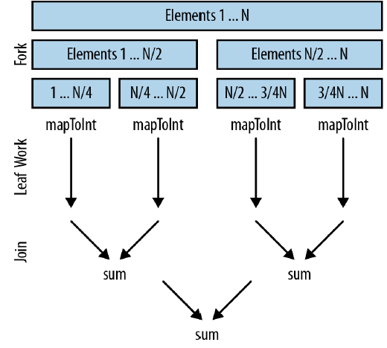
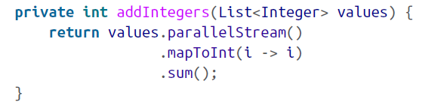
Data Parallelism (cont.)
Stream object has a method parallelStream() tht is executing streams in parallel.
Java 8 includes parallel array operations:
parallelPrefix
parallelSetAll
parallelSort

Slide 17
Conclusions
A stream is not a data structure, only a view of a data source.
A stream is functional in nature.
Operations on a stream will not be executed immediately, they are lazy operations.
The elements of a stream are only visited once during the life of a stream.

Slide 18

Bibliography
http://en.wikipedia.org/wiki/Java_(programming_language)
AWP Java SE 8 for the Really Impatient
https://stackify.com/streams-guide-java-8/

